Slide 1
Basic VLSI System Design

Slide 2
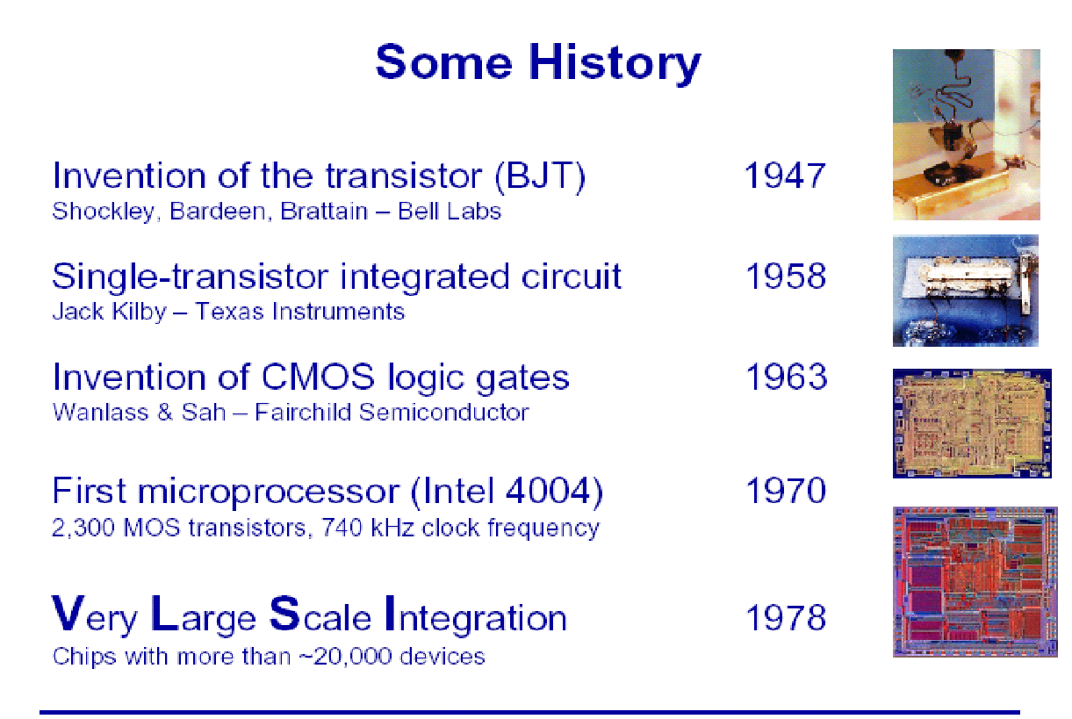
Introduction to VLSI Design

Slide 3
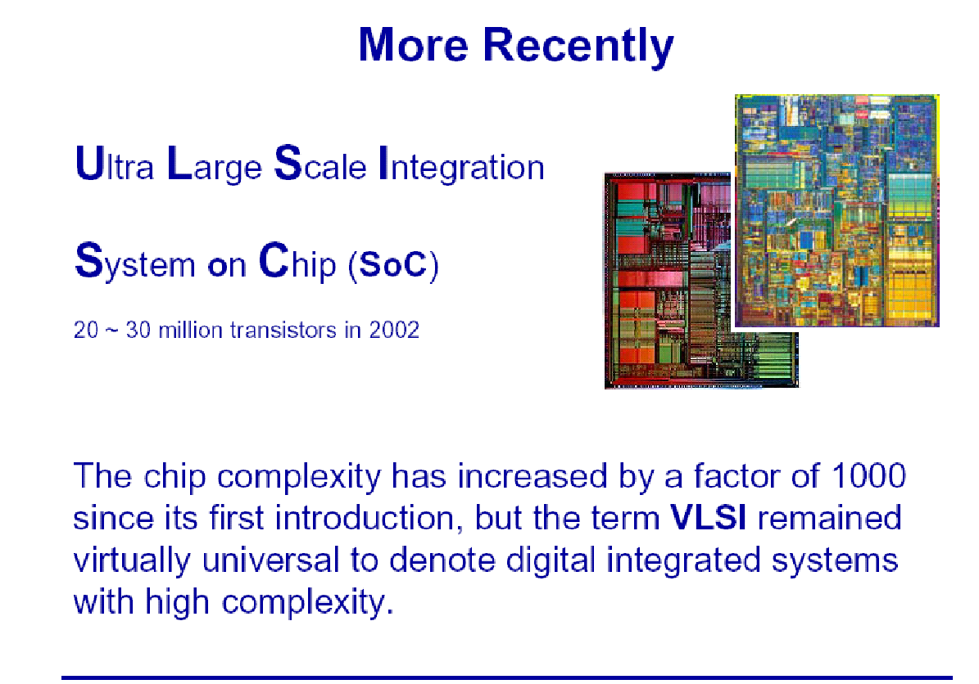

Slide 4


Slide 5
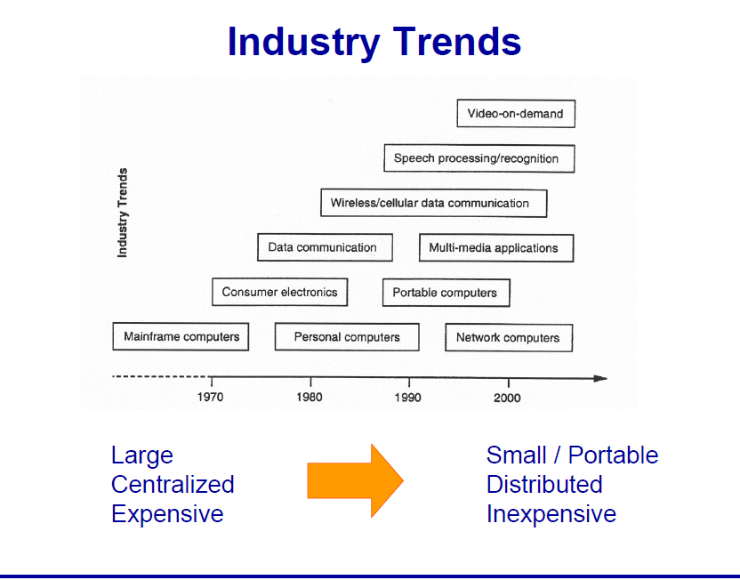

Slide 6


Slide 7
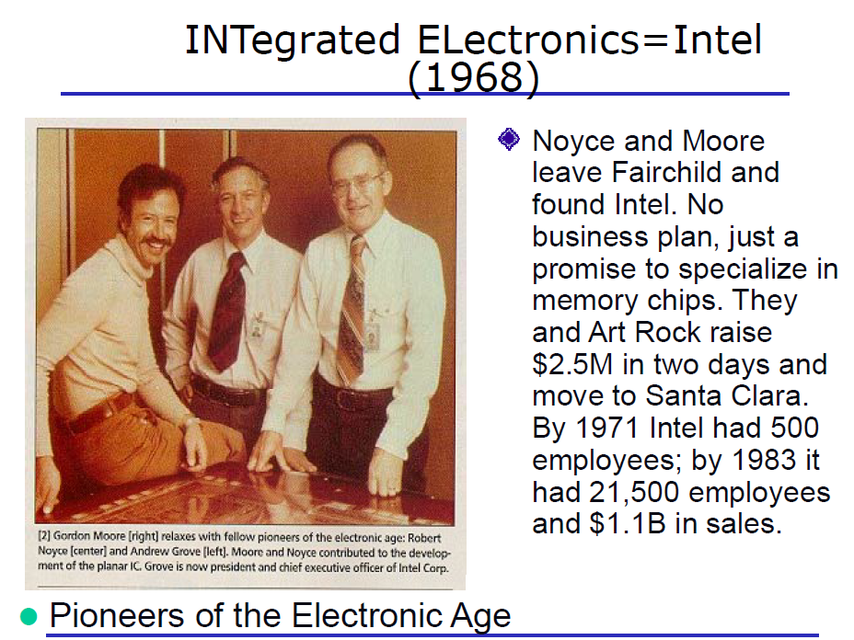

Slide 8
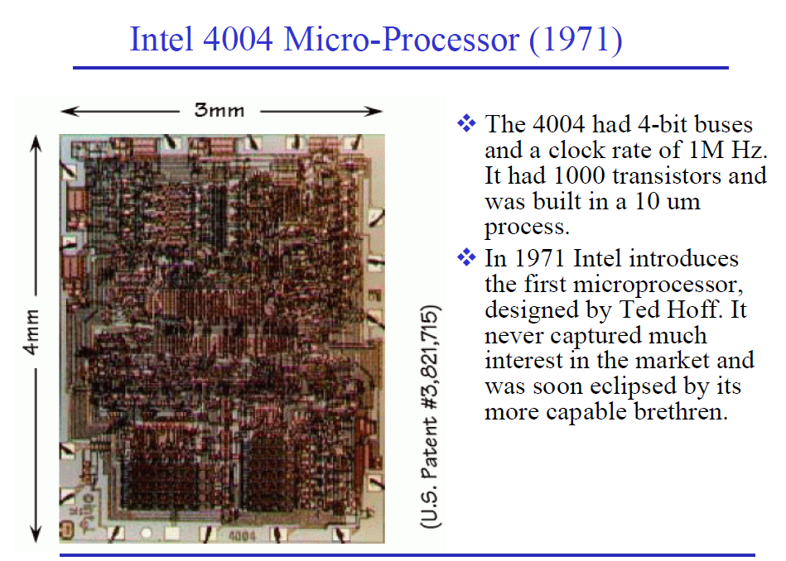

Slide 9
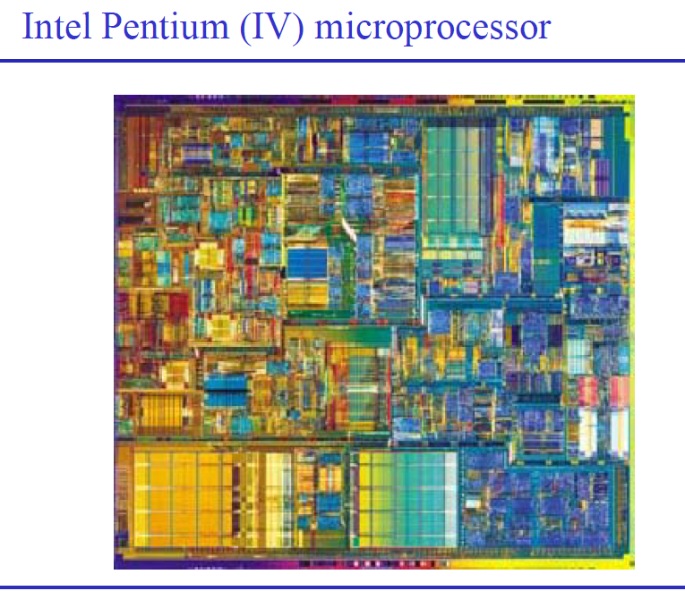
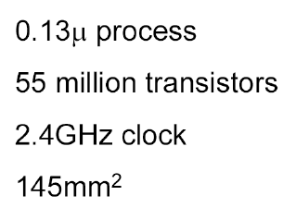

Slide 10
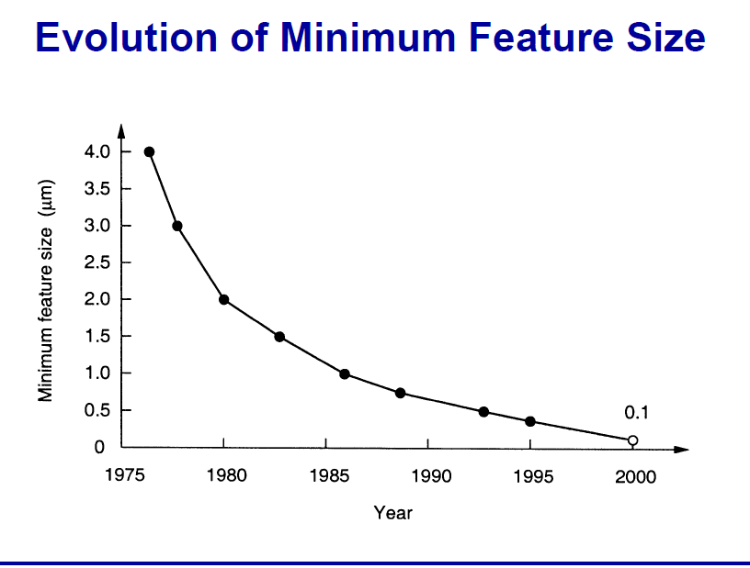

Slide 11
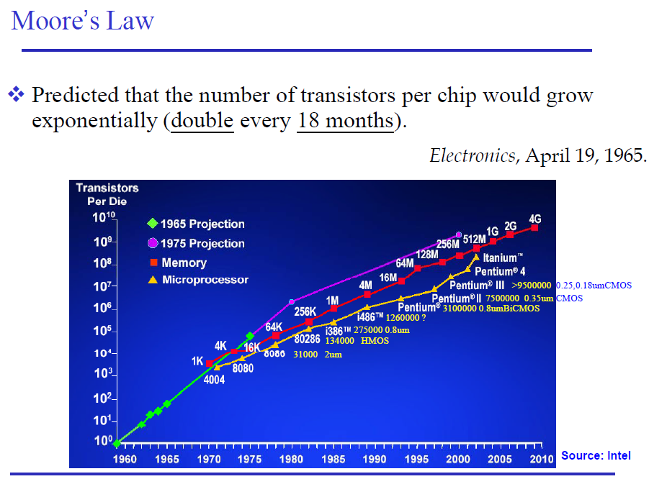

Slide 12
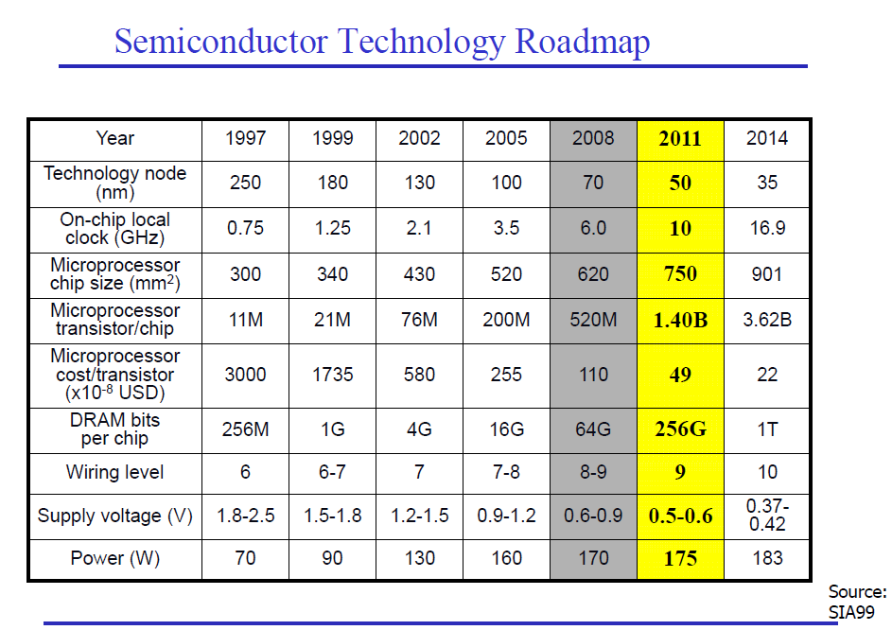

Slide 13
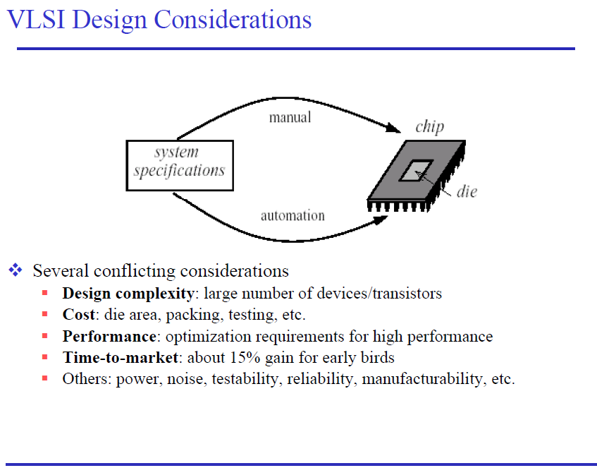

Slide 14
Design Abstraction Levels
SYSTEM
MODULE
+
GATE
CIRCUIT
DEVICE
G
S
D
n+
n+

Slide 15
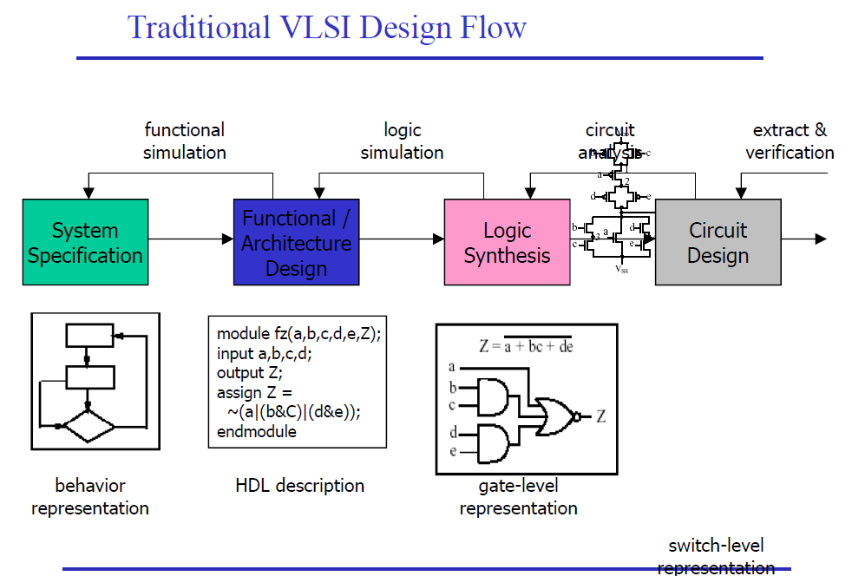

Slide 16
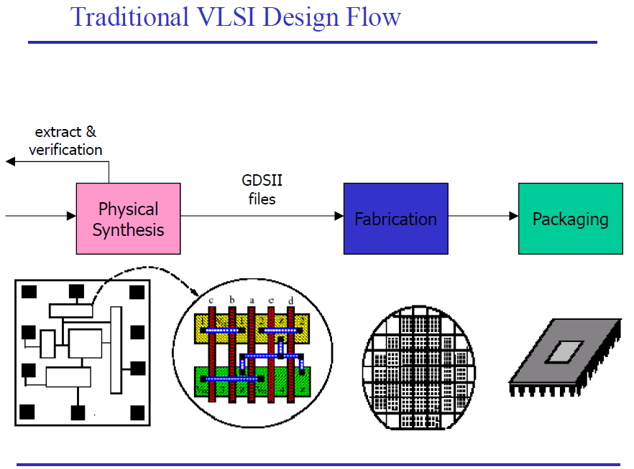

Slide 17
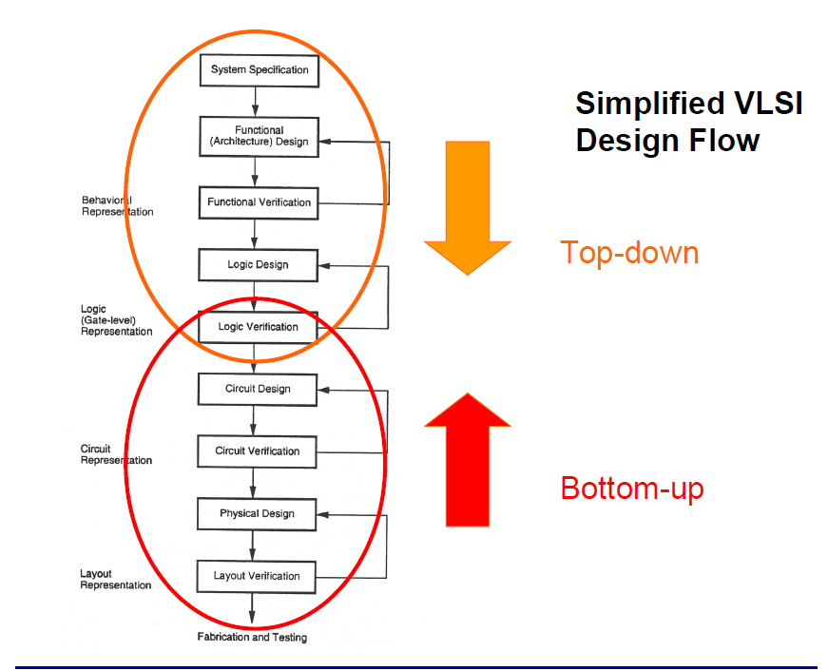

Slide 18
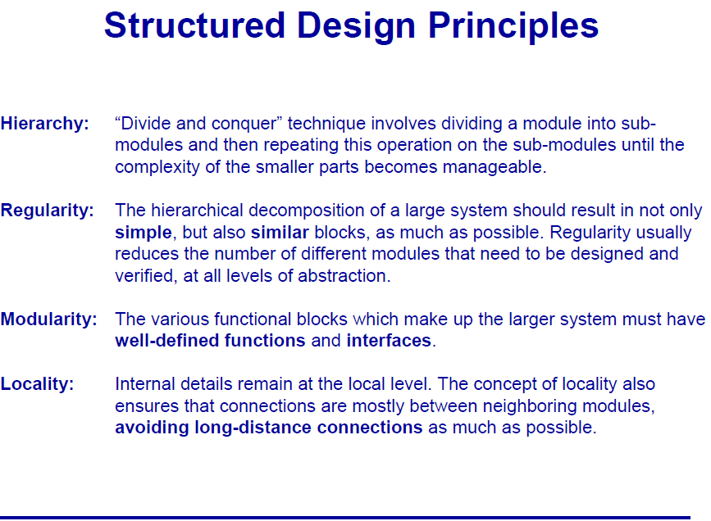

Slide 19
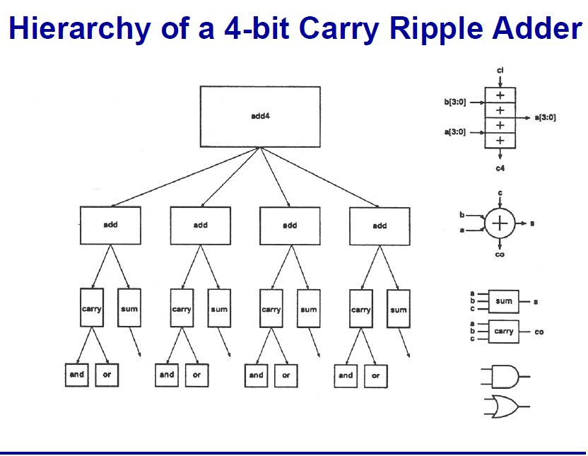
Design Hierarchy
The design hierarchy involves the principle of "Divide and Conquer." It is nothing but dividing the task into smaller tasks until it reaches to its simplest level. This process is most suitable because the last evolution of design has become so simple that its manufacturing becomes easier..

Slide 20
Reference
CMOS digital integrated circuits by Sung –Mo KANG Y.Lebeleci 4th Edition,Mc-Graw Hill publications.

